Slide 1
Welcome to Curriculum Night!
Sarah Carlson- 2017

Slide 2
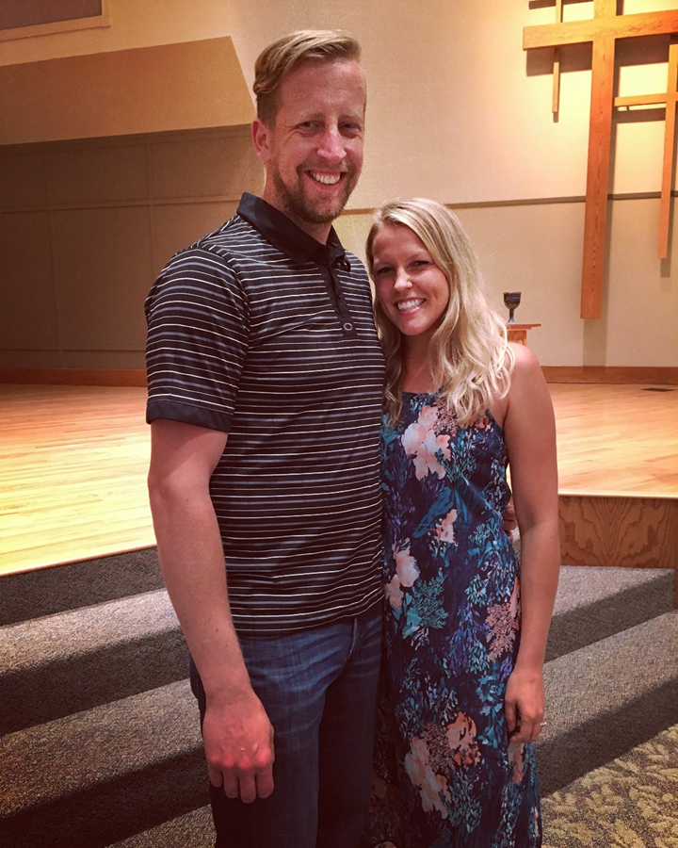
A little bit about me…
K-6 Elementary License,
5-12 Math License
7th Year Teaching - 6th year teaching 5th grade at Eagle Ridge Academy
Currently working on my Master’s Degree in Education with a specialization in elementary science
Family: Husband Pete works for US Bank
Hobbies/Interests: Being outside, travelling, biking, hiking, spending time with family and friends

Slide 3
Classes
History – Core Knowledge Base
Science – Core Knowledge and State Standards
English (Shurley English with writing component)
Wordly Wise Vocabulary
Math
Intermediate 5: Mrs. Molnar
Course 1: Mrs. Soerens
Course 2: Carlson
Reading – Novel Based Units
We may teach at a different pace or use a different style for each class depending on the needs of the students.

Slide 4
Grading Percentages
Reading*, Math, Science, History
Tests/Quizzes – 70%
Novel Homework/Classwork – 20%
Work Habits – 10%
* Poetry is worked into the reading grade.
English:
Shurley English Tests: 35%
Homework (English & WW) – 15%
Wordly Wise & Spelling Tests– 25%
Writing (Essays & Creative) – 15%
Work Habits – 10%

Slide 5
Homework Help
When: Mondays through Thursdays after school until 4:00pm.
Where: Fifth grade classroom
Who: Quarter 1 will be by invitation and Quarters 2-4 will expand to students with a C grade or lower.
(Homework help is only available for current 5th grade students. Please make other arrangements for siblings.)
Cost: FREE!
How do I sign up? Please email your child’s teacher by 12:00pm on the homework help day if you would like your child to attend. If your child plans on attending every Monday, etc…, you can let us know that and not have to email every week.
Transportation: Unfortunately, late bussing is not available. You will have to pick up your child at 4:00 from door 2. TEL is also available until 6:00 for a fee. Contact Jenny DeBrey for more information regarding TEL. jdebrey@eagleridgeacademy.org

Slide 6
Work Habits
Follows Directions the First Time: Student is able to follow a direction without reminders. Student understands classroom routines and follows them with integrity.
Neatly Completes Notes and Classwork: Student completes notes as expected during class. Notes are complete, neat, and organized.
Organization of Materials, Prepared: Student puts notes, homework, and classwork in correct folders. Student comes to class prepared with all necessary materials.
Show Excellence in All Work: Student submits work that demonstrates his/her best work. Student turns in homework on time. Student shows integrity in the completion of homework.

Slide 7
Work Habits
SLANT During Teacher Instruction and Whole Group Discussion: Student remains engaged in class discussion by showing SLANT. (Sit up Straight, Listen, Ask and Answer Questions, Nod your Head, Track the Speaker) Student raises his/her hand to speak, waits to be called on, and stands to answer.
Positively Contributes in Small Group Work: Student asks and answers questions and remains focused during small group work. Student shows respect to others within his/her group and in other groups.
Stamina to Persevere through Independent Work: Student uses time wisely in class. Student is able to focus on work without distracting him/herself or others. Student shows perseverance through difficult concepts or problems.

Slide 8
 | English (Includes WW) | Reading (Includes Poetry) | Science | History | Comments | What does this look like?
Follows Directions the First Time |  |  |  |  |  | Student is able to follow a direction without reminders. Student understands classroom routines and follows them with integrity.
Neatly Completes Notes and Classwork |  |  |  |  |  | Student completes notes as expected during class. Notes are complete, neat, and organized.
Organization of Materials, Prepared |  |  |  |  |  | Student puts notes, homework, and classwork in correct folders. Student comes to class prepared with all necessary materials.
Shows Excellence in All Work |  |  |  |  |  | Student submits work that demonstrates his/her best work. Student turns in homework on time. Student shows integrity in the completion and correction of homework.
SLANT During Teacher Instruction and Whole Group Discussion |  |  |  |  |  | Student remains engaged in class discussion by showing SLANT. (Sit up Straight, Listen, Ask and Answer Questions, Nod your Head, Track the Speaker) Student raises his/her hand to speak, waits to be called on, and stands to answer.
Positively Contributes in Small Group Work |  |  |  |  |  | Student asks and answers questions and remains focused during small group work. Student shows respect to others within his/her group and in other groups.
Stamina to Persevere Through Independent Work |  |  |  |  |  | Student uses time wisely in class. Student is able to focus on work without distracting him/herself or others. Student shows perseverance through difficult concepts or problems.
TOTAL
Student Assessment
0-5 = Not Yet; 6-7 = Progressing; , 8-9 = Meets; 10 = Exceeds

Slide 9
English & Writing
Shurley English
Includes a strong grammar component which can be difficult for new students.
Link to a parent help packet is on the website.
Classifying sentences, jingles, and grammar and spelling rules
Writing assignments about once every two weeks.
Classroom Practices (CP) are in the book.
Worksheets are handed out in class.
If I give writing assignment, the details will be on Planbook.

Slide 10
Wordly Wise Vocabulary
There are 20 units in Wordly Wise.
15 words per unit
Some weeks we will not have a WW unit.
Students will complete 5 assignments and other classroom activities.
Students can also use the Wordly Wise website or app. http://wordlywise3000.com/

Slide 11
Word Study
Pattern-based spelling curriculum
Students sort the words and interact with them each week
5th grade focuses on Latin root words, prefixes, and suffixes
Parents will need to initial the homework menu that comes home
Types of activities:
Practice & Write Sort
Word Hunt
Blind Sort
Speed Sort
Open Sort

Slide 13
Saxon Math
Spiraled Curriculum
Students are leveled for math. Though the majority are in Course 1, we have a full class of Course 2.
The beginning of the year there is a lot of review. Some students may say it is too easy. It gets significantly more difficult midyear.
It is vital that students know their multiplication and division facts to be successful this year.
From Saxon’s Website: For over 30 years, Saxon Math™ has been delivering proven results for students in Grades K–12. The Saxon Math curriculum has an incremental structure that distributes content throughout the year. This integrated and connected approach provides deep, long-term mastery of the content and skills.

Slide 14
Science
Textbook: Science: A Closer Look
State Standards Units:
• Natural Resources
• Ecosystems
• Animal Adaptations
• Force and Motion/Simple Machines
Core Knowledge Units:
• Chemistry: Periodic Table, Atoms, Molecules, and Compounds
• Classifying Living Things
• Cells
• Plant Structures and Processes
Homework assignments about once or twice a week
The students will take the Science MCA test in May.
This will cover standards in grades 3-5.

Slide 15
History
World Lakes
The Maya, Aztec, and Inca Civilizations
Geography of Central and South America
Native Americans: Cultures and Conflicts
The Renaissance
The Reformation
Geography of Europe
England: Golden Age to Glorious Revolution
The Age of Exploration
Early Russia
Feudal Japan
Westward Expansion before the Civil War
The Civil War
Westward Expansion after the Civil War
Geography of the United States

Slide 16
Reading/Literature
Where the Red Fern Grows (Wilson Rawls)
Coming Up:
Tom Sawyer (Mark Twain)
Episodes from Don Quixote (Miguel de Cervantes)- Core Classics edition novel
Little Women - abridged version (Part First) (Louisa May Alcott)
Narrative of the Life of Frederick Douglass (Frederick Douglass)- Play Adaptation
The Secret Garden (Frances Hodgson Burnett edition) **
Tales of Sherlock Holmes (Arthur Conan Doyle)- Core Classics edition novel
A Midsummer Night’s Dream - No Fear Shakespeare (William Shakespeare) **
** These stories are older than 100 years old and have free e-books and audio books available. **
Most units will include a vocabulary test in which students match vocabulary words used in the book to definitions. It is helpful for students to practice their study skills and study at home and school. Not studying can be detrimental to their reading grades.

Slide 17
Reading Assignment Grading
I read the assigned chapters completely. | I restated the questions, answered in complete sentences, and used specific details from the text. | I did my best work on the worksheet. (It is in class, complete, and done with effort.) | I reflected on my answers and added to the answers in pen during class discussion. (Incomplete answers are filled in with pen.) | I participated in the class discussion (asked or answered questions, tracked the speaker, sat up straight, and listened to the discussion).

Slide 18
Poetry
We will have two poetry units this year.
Includes learning the major analytical terms.
Analyzing classic poems (list on the website – Core Knowledge)
Memorizing poems including The Road Not Taken by Robert Frost
Students will take notes for each poem, and there will be a final exam.

Slide 19
Grading
Infinite Campus updated at least once a week
Late work –
May take up to a week to be recorded.
Students must hand in late work in the proper place.
Automatically 20% off.
Students have until the following Friday at 8:00am to hand in any missing work.
Infinite Campus Flags:
Blanks - no score is recorded yet. (Don’t worry!)
M - Missing assignment – counts as a zero.
Some assignments are for practice. Not every assignment or activity will be in the gradebook.
I send out regular emails via Infinite Campus to let you know about missing work and/or low grades.
Please check IC on a regular basis.
The Infinite Campus app is more user friendly and will send you notifications when grades are entered. District ID: GXWPLC

Slide 20
Cursive
We will be teaching and using cursive in 5th grade. Students will write exclusively in cursive starting 2nd quarter.
Cursive is required in 6th grade.

Slide 21
Note Taking
Students will be taking notes using a Cornell notes system.
We will teach students to take notes and practice note taking together.

Slide 22
Cornell Notes
Name: _____________________________________________ Date: ______________________________________ Topic: _____________________________________________ Class/Subject: ____________________________
Key Points | Details
Summary/Reflection/Questions:

Slide 23
Pillars - CIPHER
Citizenship
Integrity
Perseverance
Honor
Excellence
Respect
We weave these virtues into everything we do at ERA. Students are expected to be striving toward these pillars in their actions and attitudes.
They do – and it shows!

Slide 24
Pillar Acknowledgement System
Pillar Stickers
Monthly Raffle
Pillar Club (every Friday for 20 minutes)
No fix its
All homework in from the past two weeks
Traveling Eagle – Aquila
The English word eagle comes from Latin aquila.
Pillar Poster with Eagle Feathers

Slide 25
Website & Communication
Planbook: Homework & 5th Grade Events
Worksheets and notes
Classroom Website
Important Links & Resources
The best way to contact me is via email. scarlson@eagleridgeacademy.org
Please allow one business day for a response.
If I have not returned your email in one day, feel free to send/forward it to me again. Rarely, one gets lost or forgotten.
It is difficult to return phone calls during the school day.

Slide 26
Science Museum Camp-In
Cost: $50 plus transportation – we may be able to fundraise for some of this cost through Free Dress Days
Includes:
General admission into the museum exhibit halls and/or Omnitheather
"Explore Science" workshops/stations
A Science Live theatre production
Specially designed activities, worksheets, and handouts
An overnight stay in selected museum exhibit halls with Camp-In staff
A pizza dinner
Late-night snack
Continental breakfast

Slide 27
Homework Philosophy
Please review the “Eagle Ridge Lower School Homework Philosophy” and the student/parent handbook.
If you need further assistance on homework including strategies of completion or student accountability, please email me. I can give you advice specific to your student.

Slide 28
Odds and Ends
We have a community supply system.
Reduces desk messiness
Frees up desk space
Helps students focus
Birthdays
Feel free to send a “trinket” or donate a book to the classroom.
Send only non-edible things to share

Slide 29
Class Schedule
 | Day One | Day Two | Day Three | Day Four | Day Five
8:00-8:15 | Wordly Wise/ Handwriting | Wordly Wise/ Handwriting | Wordly Wise/ Handwriting | Wordly Wise/ Handwriting | Wordly Wise/ Handwriting
8:15-8:40 | Latin | Music | Latin | Music | Art (8:15-9:05)
8:45-9:10 | PE | PE | Music | PE
9:10-10:20 | Math | Math | Math | Math | Math
10:20-11:50 | 10:20-11:05 Science 11:05-11:50 English | 10:20-11:05 History 11:05-11:50 English | 10:20-11:05 Science 11:05-11:50 English | 10:20-11:05 Science 11:05-11:50 English | 10:20-11:05 Science 11:05-11:50 English
11:50-12:15 | Lunch | Lunch | Lunch | Lunch | Lunch
12:15-12:40 | Recess | Recess | Recess | Recess | Recess
12:45-3:00 | 12:45-1:45 History 1:45-1:55 Snack Break 1:55-2:55 Reading | 12:45-1:10 Latin 1:10-1:45 Language Arts 1:45-1:55 Snack Break 1:55-2:55 Reading | 12:45-1:45 Reading 1:45-1:55 Snack Break 1:55-2:55 History | 12:45-1:45 Reading 1:45-1:55 Snack Break 1:55-2:55 History | 12:45-1:45 History 1:45-1:55 Snack Break 1:55-2:55 Reading
3:00 | Dismissal | Dismissal | Dismissal | Dismissal | Dismissal

Slide 30
Thank you for Coming!
Any Questions?

