Slide 1
Scientific Method—Be a Scientist

Slide 2
Scientific Method
A procedure scientists use to help them explain why things happen the way they do.

Slide 3
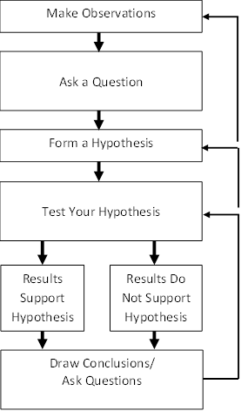

Slide 4
Variable
A factor that can be changed in an experiment and might affect the outcome

Slide 5
Hypothesis
an educated guess about what the answer to a scientific question might be

Slide 6
Analyze
Examine in detail

Slide 7
data
Information that is obtained from observation or experiments

Slide 8
Identify what the two scientists did at each step of the scientific method.
Make observations
Ask a question
Form a hypothesis
Test your hypothesis
Did the data prove or disprove the hypothesis?
Draw conclusions/ask questions

Slide 9
Question:
Does malaria transmitted between different organisms behave the same way inside different hosts?

Slide 10
Hypothesis
The cells of malaria parasites in lizards and sand flies will be similar to the malaria parasites that scientists have observed in mosquitoes and in humans.

Slide 11
Scientific Method Quiz on Thursday!
Know the definitions of the following words:
Scientific method, variable, hypothesis, analyze, data
Know the steps of the scientific method

